Slide 1
Local Cloud Computing with Openstack and BDAS
Faculty Advisor: JIA ZHANG, WEI WANG
Team:
ZILONG HUANG, MOHAN YANG,
YUWEI YANG, TONGTONG BAO, RAO LI

Slide 2
Roadmap
Motivation and Difficulty of the project
Related Work
Original design (using XenServer)
Challenges when using Xen
New design and Challenges (using simple Ubuntu Server)
Demo
Conclusion and future work

Slide 3
Introduction
This project try to build up a local cloud computing environment using Openstack and Berkeley Data Analytic Stack.
Try not only launch simple instance, but also deploy large data processing cluster in a simple and user-friendly way

Slide 4
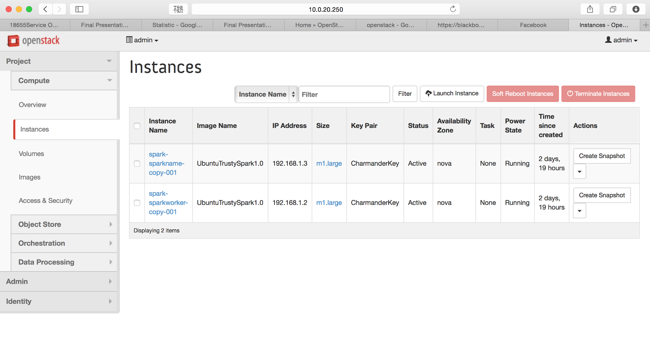
Introduction

Slide 5
Motivation
The local cloud can use the existing resource of the campus.
Current Cloud Computing service is expensive.
Current Cloud Computing service could not provide highly customized service.
We have our local servers, why not make full use of it?

Slide 6
Why it is difficult?
There is no very suitable tutorial for the setup from scratch.
We have to read through many material, some might be outdated, some might be not very suitable for our environment
What we do is to read, try and then combine different tutorials, material and configure a suitable local cloud computing environment.

Slide 7
Related Work
XenServer
BDAS
Openstack

Slide 8

XenServer
Citrix XenServer is an industry and value leading open-source virtualization platform for managing cloud, server and desktop virtual infrastructures.

Slide 9
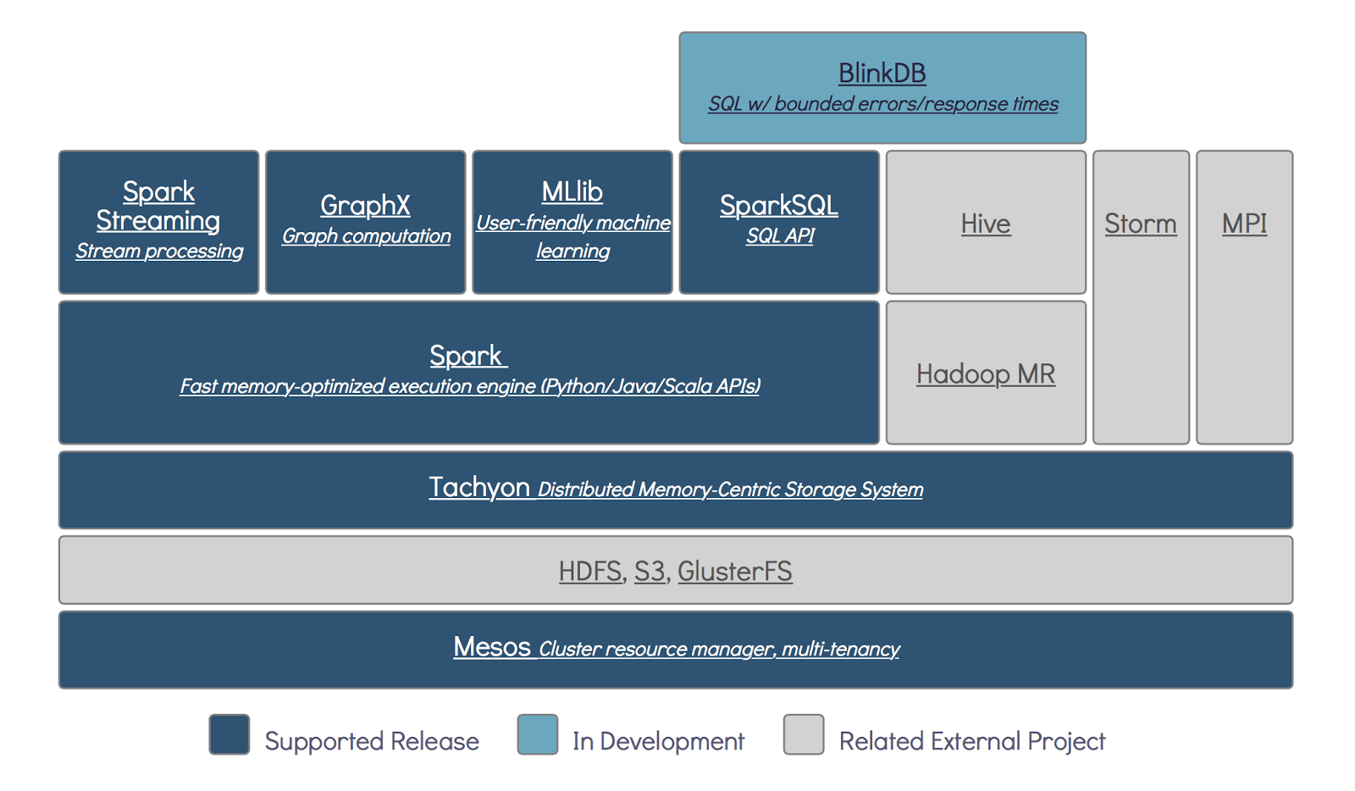
Berkeley Data Analytic Stack

Slide 10
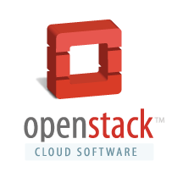
Openstack
OpenStack is a free and open-source software cloud computing software platform.^{[2]} Users primarily deploy it as an infrastructure as a service (IaaS) solution.

Slide 11
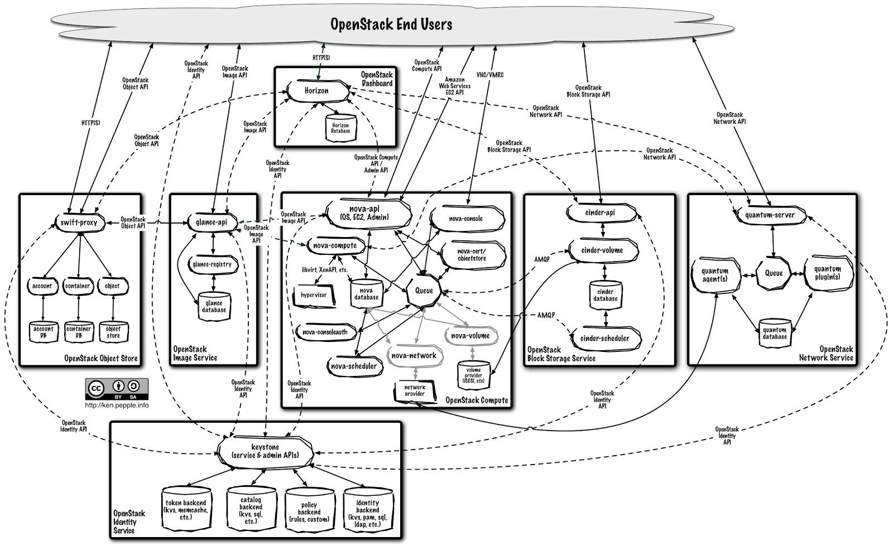

Slide 12
Horizon - Web UI Dashboard

Slide 13
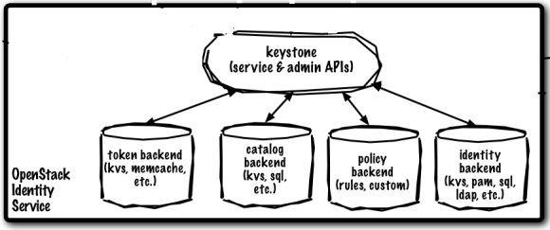
Keystone
Authentication for all components

Slide 14
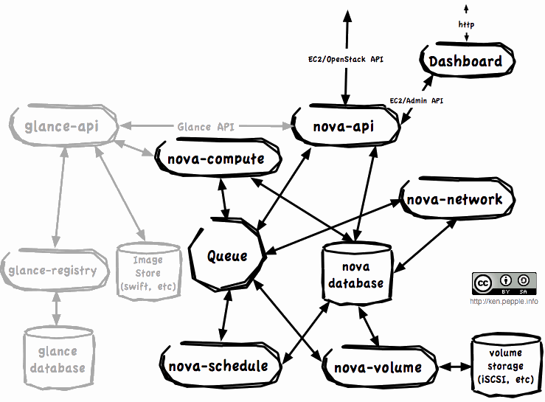
Nova - Compute project (EC2)
Scheduler, basic network, resource management, launch instances

Slide 15
Glance
Provide discovery, storage, retrieval of VM images for Nova

Slide 16
Cinder - Block storage
Storage resource to be used by Nova
Virtualize pools of block storage

Slide 17
Swift - Object Store (S3)
cloud storage optimized for durability, availability and concurrency
unbounded and unstructured data
features: simple API, versioning, ACL

Slide 18
Heat
provide orchestration service of instances
launch composite cloud applications based on templates
use with Sahara (more on this later)

Slide 19


Original Design (abandoned)
BDAS
OpenStack
XenServer
Physical Server

Slide 20
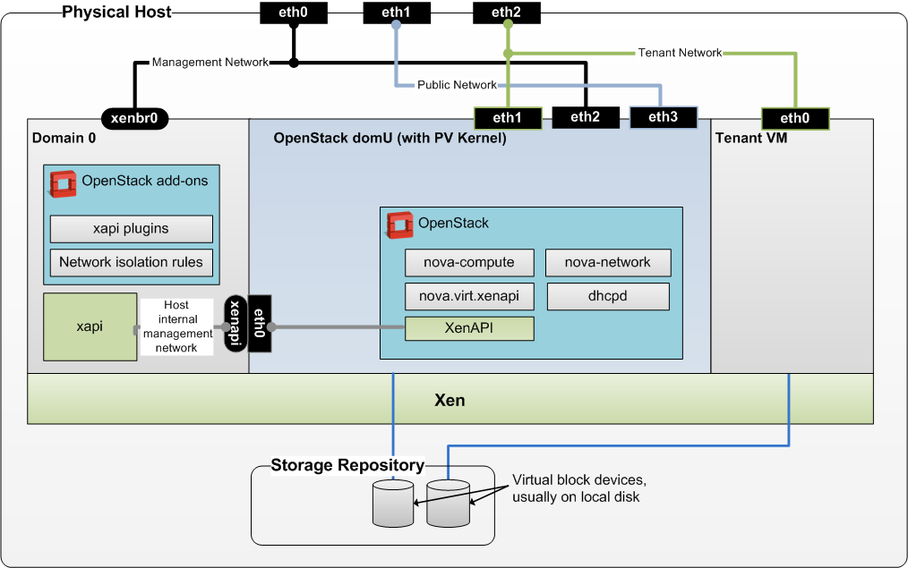
How does XenServer and OpenStack work together

Slide 21
How to install Openstack on a XenServer?
Introduction:
Step 1. prepare the XenServer for the installation of Openstack
Step 2. use install_os_domU.sh to install a new VM as Openstack platform.
Reference:
https://github.com/openstack-dev/devstack/tree/master/tools/xen

Slide 22
Prepare XenServer for Openstack
convert LVM virtual disk to extension 3 format
Install Xen API Plugins so that XenServer API could be invoked by OpenStack to launch Virtual Machine
Reference:
https://github.com/QawsQAER/PersonalOpenStack/blob/master/prepare_xen_for_openstack.sh

Slide 23
Challenges for using Xen
XenServer(s) are originally connected as a server pool, so install_os_domU.sh has problem to identify the host to install Openstack specified Virtual Machine.
Need to detach the server in order to install DomU for Openstack
However, detaching XenServer from server pool is buggy, need to reinstall the whole hypervisor.
So we reinstall XenServer

Slide 24
Challenges for using Xen
Network does not work properly
XenServer with Openstack, assuming there are 3 NICs (but there are only 2 NICs).
DomU running Openstack has only 3 NICs
Could be solve with VLAN
3. Cinder does not work properly
a. Cannot upload new images
b. Need extra work to configure a new local storage repository on XenServer to serve for Openstack Cinder.

Slide 25
Challenges for using Xen
When trying to configure a new local SR, one wrong command can delete the original SR, and everything is deleted.
Unluckily, this wrong operation is carried out on the master server of a server pool, so that the whole server pool crashed, as the configuration of the server pool is on this server.

Slide 26

NOOOOOOOO
OOOOOOOOO
OOOOOOOOO
OOOOOOOOO

Slide 27
Decide to abandon XenServer
Given that we have crashed XenServer
XenServer with Openstack needs many manual configuration (SR, network), and does not necessarily support hadoop and spark communication.
We decide to change to a new design.

Slide 28
New Design
BDAS
OpenStack
Ubuntu
Physical Server

Slide 29
DevStack
DevStack is a set of scripts and utilities to quickly deploy an OpenStack cloud.
It’s a automatic tool to install and configure all the components of Openstack.
Configuration based on a localrc/local.conf file.
reference:
https://github.com/openstack-dev/devstack

Slide 30
Openstack Configuration file
#----NETWORK CONFIGURATION----#
#The IP address of the current host of openstack
HOST_IP=10.0.21.5
FIXED_RANGE=192.168.1.0/24 #Default value lead to incapability of network connection
FIXED_NETWORK_SIZE=256
FLOATING_RANGE=10.0.21.0/29
MYSQL_PASSWORD=pass
SERVICE_TOKEN=pass
ADMIN_PASSWORD=pass
SERVICE_PASSWORD=pass
RABBIT_PASSWORD=pass
SWIFT_HASH="66a3d6b56c1f479c8b4e70ab5c2000f5"
enable_service s-proxy s-object s-container s-account

Slide 31
SAHARA -- Why need this?
It’s very difficult for user to configure a hadoop cluster by themselves.
Sahara uses Heat to build a data processing cluster in a very automatic way, by predefined node template and cluster template, with special images.

Slide 32
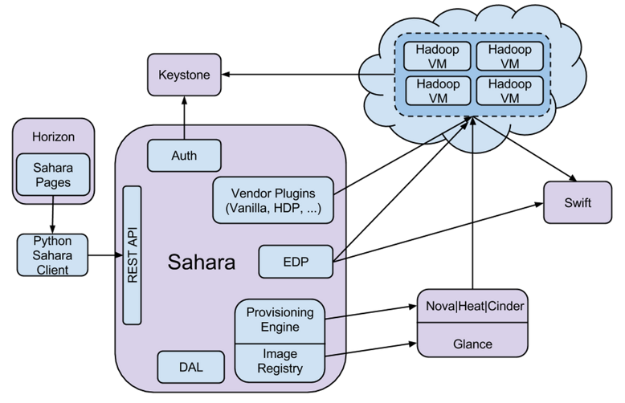
SAHARA -- Architecture

Slide 33
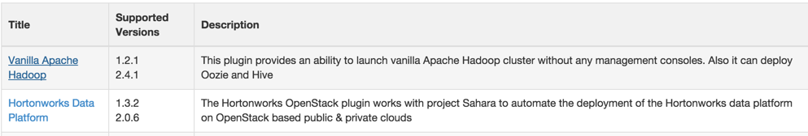
SAHARA -- Installation
Configure in localrc
$echo “enable_service sahara” >> localrc
And enable plugins for hadoop, spark
$echo “plugins=vanilla,hdp,spark” >> /etc/sahara/sahara.conf
Install new special images for data processing
glance image-create \ --name UbuntuTrustyVanilla2.4.1 \ --disk-format qcow2 \ --container-format bare \ --is-public True \ --copy-from http://sahara-files.mirantis.com/sahara-juno-vanilla-2.4.1-ubuntu-14.04.qcow2

Slide 34
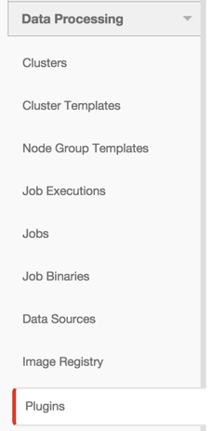
Data Processing -- Steps
Registering Image
Create Node Group Template
Create a Cluster Template
Launching Cluster
Job Binaries
Job Execution

Slide 35
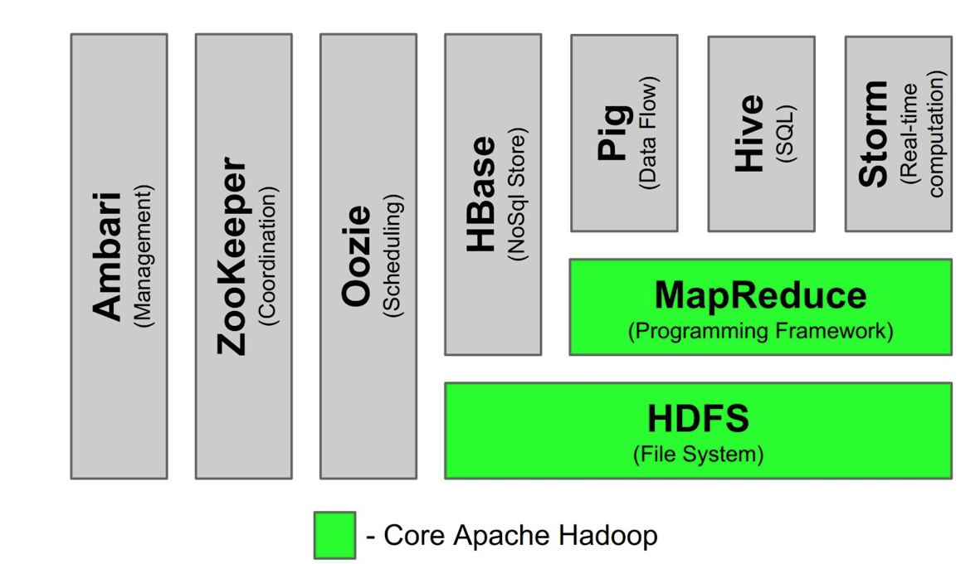
Hadoop

Slide 36
Data Processing -- Problems Encountered
As Sahara has only been released this year, we faced lots of problems.
Security Group ID and Name mismatch.
Resource CREATE failed: BadRequest: Security group 1 not found for project
Problem resolved when you set ID of security group the same as Name of security group
BUG

Slide 37
Data Processing -- Problems Encountered
Cannot select base image when launching cluster:
Successfully register image but cannot select the base image.
Problem resolved when adding tags to base image.

Slide 38
Data Processing -- Problems Encountered
Master and slaves communication problem:
After launching a hadoop cluster, the status of this cluster will stay in “waiting” for a long time until “Error” appears.

Slide 39
Data Processing -- Problems Encountered
In this long time period, some exceptions in sahara.log:
Log Info:
Final Error:

Slide 40
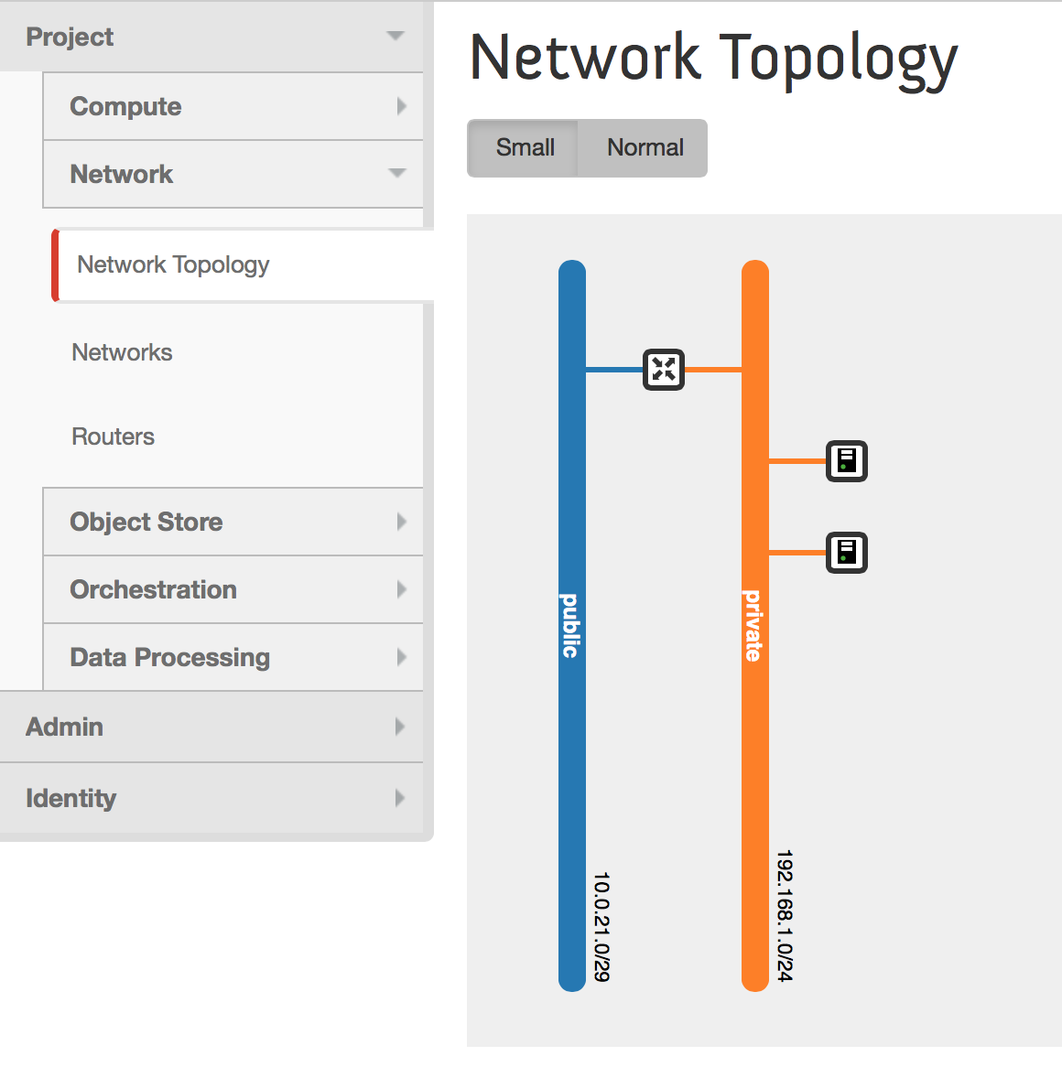
Data Processing -- Problems Encountered
We tried to use Neutron (advanced network) instead of the default nova-network to configure a more customized network.
But the routing table is messed up, so it’s not able to work properly.

Slide 41



Spark
What is the first thing flash in your mind?
A.
B.
C. (A popular song from Taylor Swift)
None of these!!!!!

Slide 42
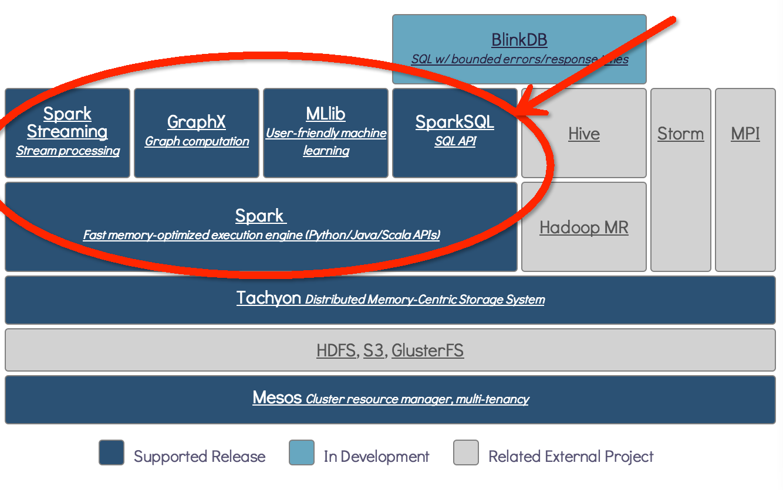

Spark
Apache Spark is a fast and general engine for large-scale data processing.

Slide 43
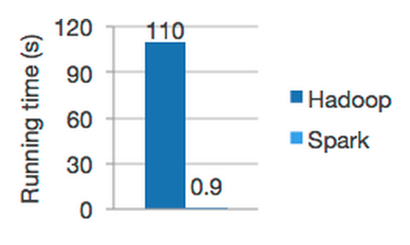
Why use Spark
(1)Speed: Run programs up to 100x faster than Hadoop
(2)Ease of Use: write applications quickly in
Java, Scala or Python
(3)Generality: combine SQL, streaming and
complex analytics
(4)Runs Everywhere: Spark runs on Hadoop, Mesos, standalone, or in the cloud. It can access diverse data sources including HDFS, HBase, S3, etc.

Slide 44

Spark Plugin-Image
Snowman tells us how to install Image
Using this shell script
glance image-create \ --name UbuntuTrustySpark1.0 \ --disk-format qcow2 \ --container-format bare \ --is-public True \ --copy-from http://sahara-files.mirantis.com/sahara-juno-spark-1.0.0-ubuntu-14.04.qcow2

Slide 45
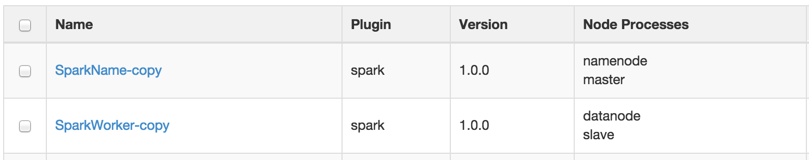
Spark Plugin-Configuration&Cluster Validation
Connect with ssh to the master using the “ubuntu” user and the corresponding key.
Cluster must contain exactly one HDFS namenode
Cluster must contain exactly one Spark master
Cluster must contain at least one Spark slave
Cluster must contain at least one HDFS datanode

Slide 46
Run Spark
1. Install scala (Using scala language)
2. Install Spark
$ wget http://www.scala-lang.org/files/archive/scala-2.10.4tgz $ tar xvf scala-2.10.4.tgz $ ln -s scala-2.10.4 scala $ export SCALA_HOME=/home/ubuntu/scala $ export PATH=$SCALA_HOME/bin:$PATH
$ wget http://d3kbcqa49mib13.cloudfront.net/spark-0.9.0-incubating-bin-cdh4.tgz $ tar xvf spark-0.9.0-incubating-bin-cdh4.tgz $ ln -s spark-0.9.0-incubating-bin-cdh4.tgz spark $ cd bin $ ./spark-shell

Slide 47
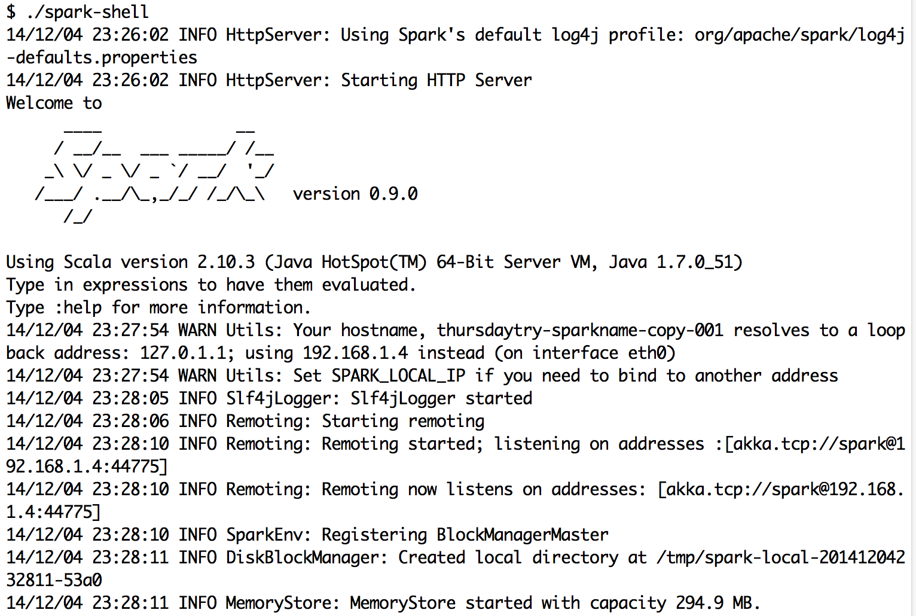
Enter in Spark successfully:
Spark’s primary abstraction is a distributed collection of items called a Resilient Distributed Dataset (RDD)

Slide 48
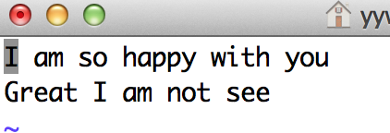
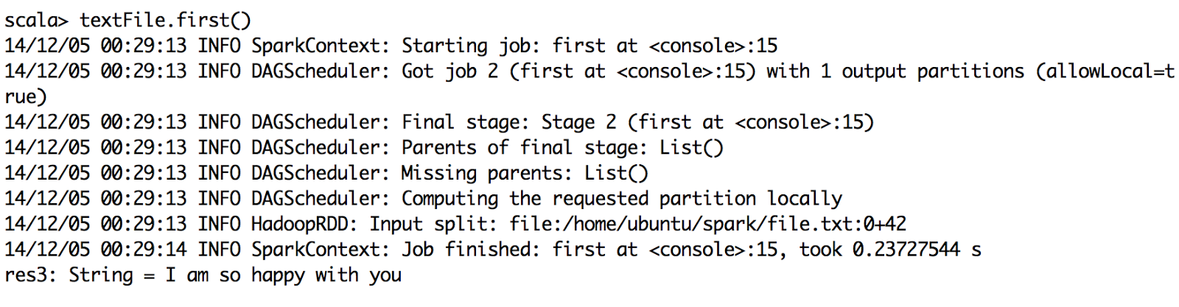
Run Map-Reduce in Spark
Input text:
We get the first item in RDD
scala> val textFile = sc.textFile(“home/ubuntu/spark/input.txt”)

Slide 49
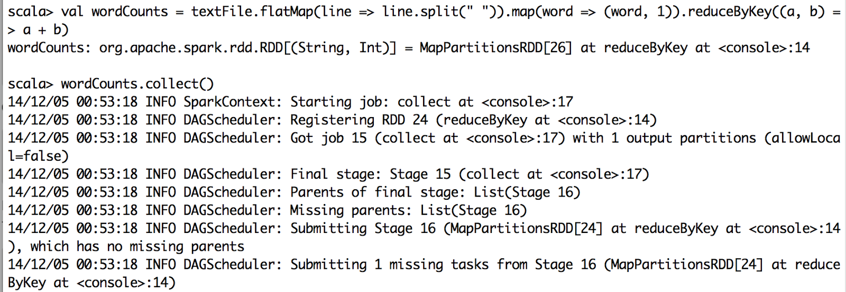
Run Map-Reduce in Spark

Slide 50
Future work
Further configure Neutron, so that the network configuration works perfectly, and the network flow will be faster
Resolve the problem that Cluster will result in Error after a certain period of time.
Configure multiple physical server(s) to serve for Openstack

